Slide 1
What is Topology and ‘Compactness'?
김종근

Slide 2
Index
1. What is Topology? : Understanding through metaphor
- Definition of Topology
- Simple Explanation
2. What is Compactness? : Unpacking the definition
- Definition of Compactness
- Example of compact sets
- Sequential compactness
- What do sequential compact sets look like?
3. Why is it important?
- (Wick) Extreme Value Theorem

Slide 3
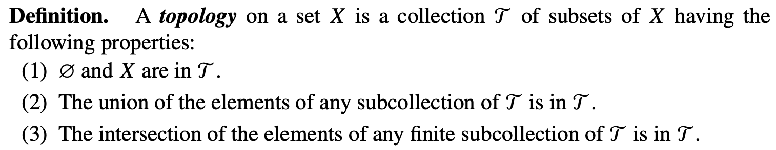

1. What is Topology?
- Definition of Topology

Slide 4
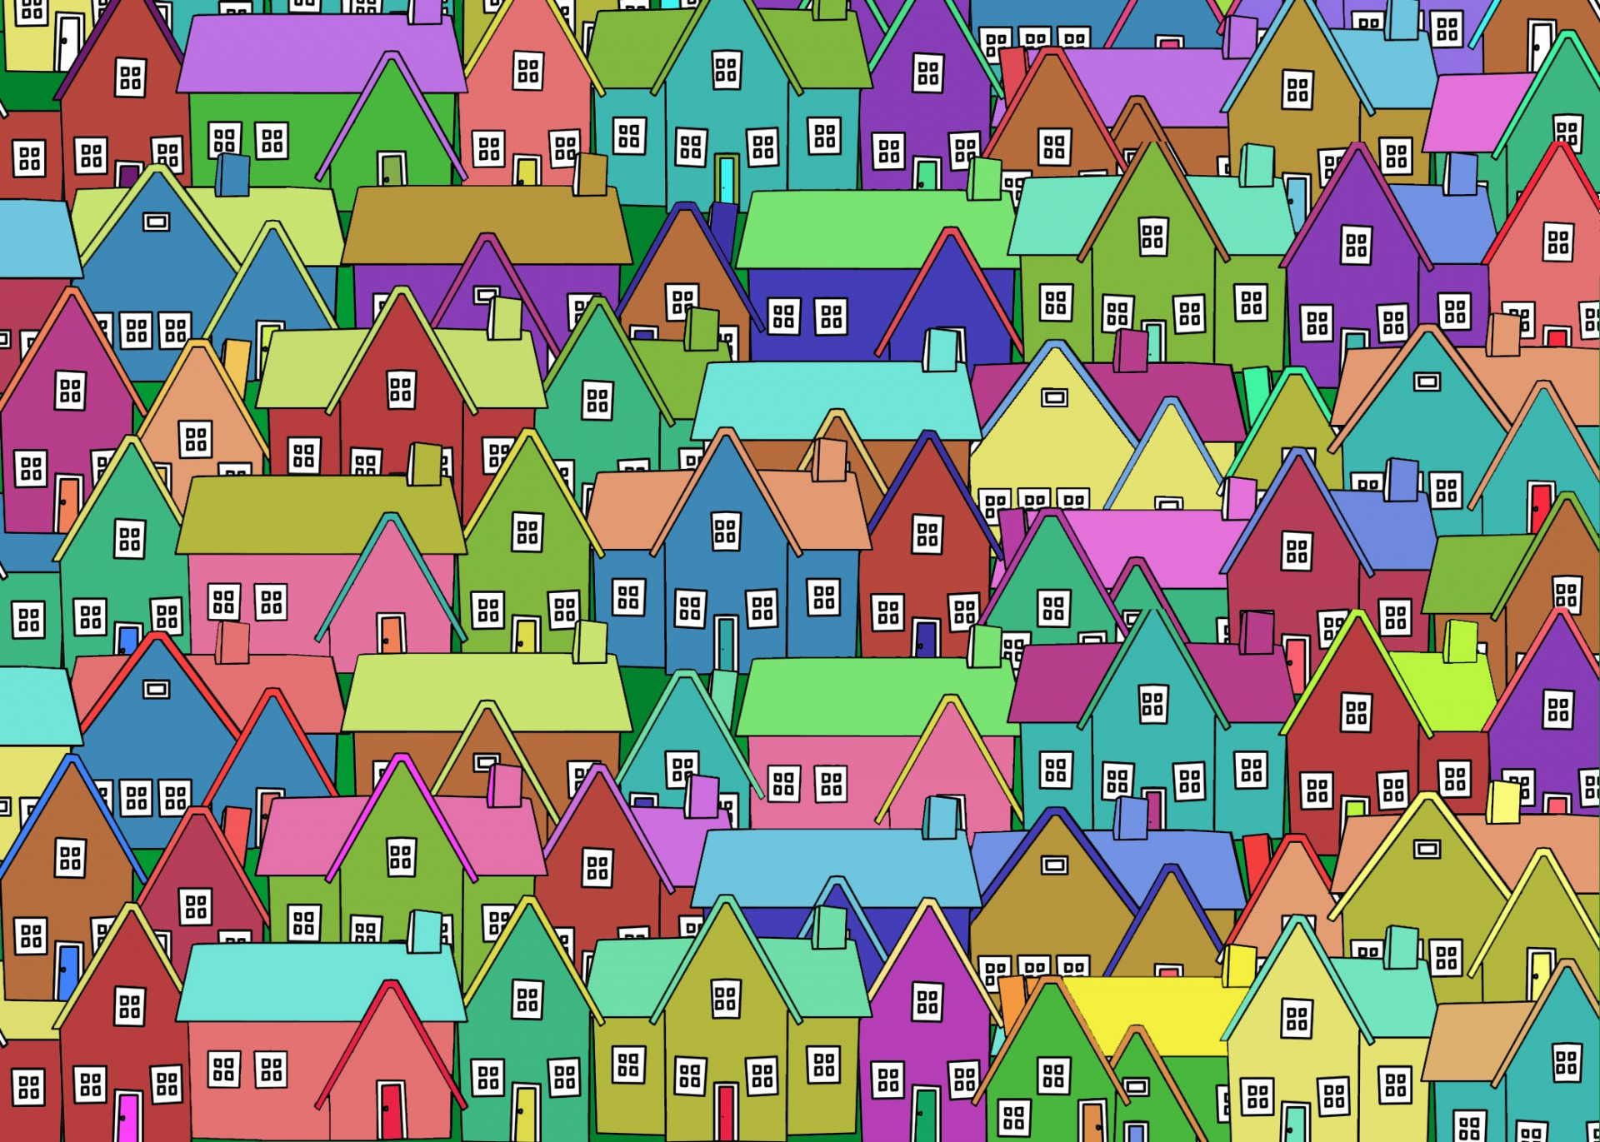
Simple Explanation about Topology
Define ‘Neighborhood’ !
How?
1. By distance
ex) Within 1km radius
2. Only acquaintance
3. Those following each other in Instagram
So many ways!

Slide 5






